Slide 1

MDS 2023:
FINAL PREPARATION
Let the Countdown Begin
California Association of Health Facilities
Terry Sheets
Consultant

Slide 2

2023 MDS Changes & Common Errors
59 New and Revised Items
New Resident Interview Questions
Social Determinants of Health
High Risk Drug Classifications
2 New QRP Quality Measures
  Transfer of Health Information to Patient and Subsequent Providers
Section G retires

Slide 3

Social Determinants of Health
Ethnicity
Race
Language
Transportation
Health Literacy
Social Isolation

Slide 4
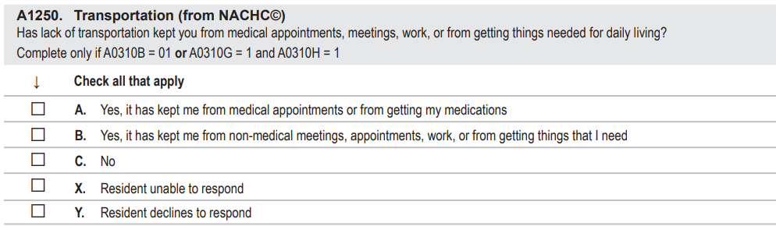
Section A1250 - Transportation
Access to transportation for ongoing health care and medications plays an essential component of overall care management. (SDOH)
6 Month – 1 Year
Lookback

Slide 5
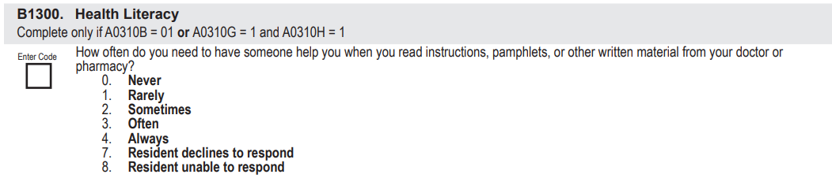
Health Literacy
Health Literacy is the degree to which individuals have the capacity to obtain, process, and understand basic health information and services needed to make appropriate health decisions. (SDOH)
Resident Self-Report Only

Slide 6
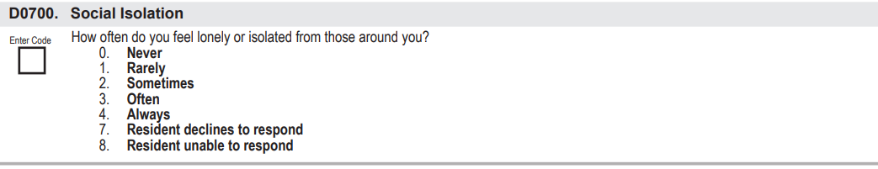
Social Isolation
Definition
Refers to an actual or perceived lack of contact with other people, such as living alone or residing in a remote area. (SDOH)
Resident Self-Report Only

Slide 7
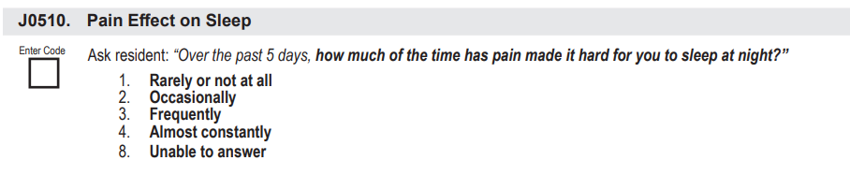
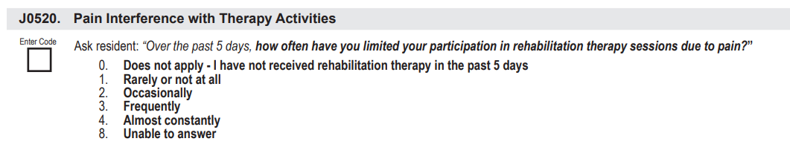
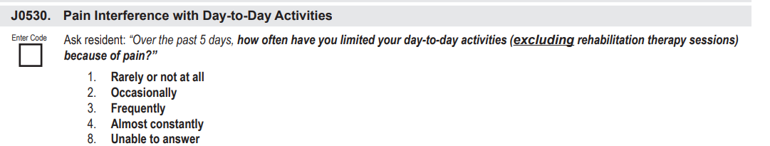
Expanded Pain Interview

Slide 8
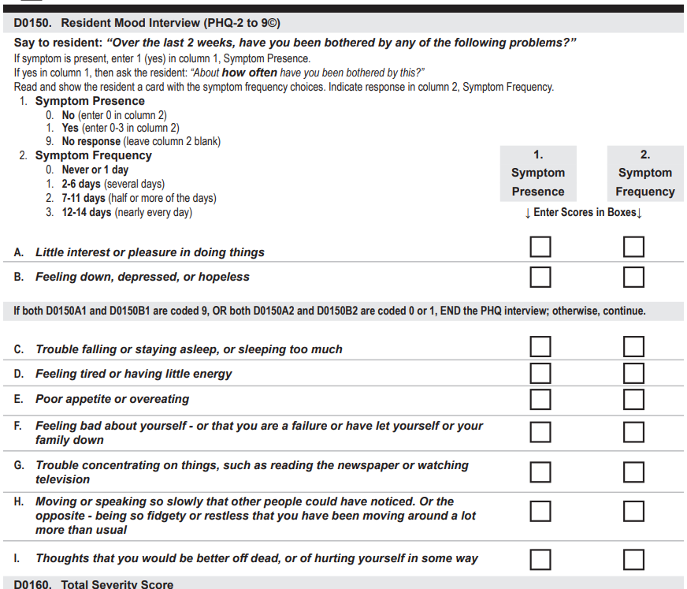
PHQ- 2 to 9
Ask each of the first two questions.
If both D0150A1 and D0150B1 are coded 9, end the PHQ interview.
If both D0150A1 and D0150B1 are coded 0 or 1, end the PHQ interview and record Total Score based on Column 2.
All other scenarios, proceed with the remaining interview.

Slide 9
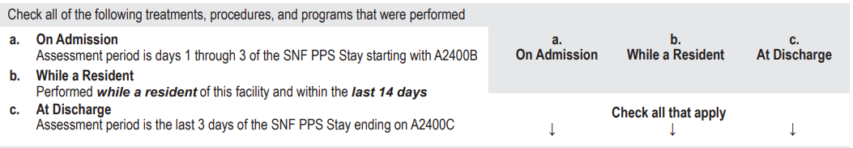
New Look Back Period
Medicare A Only
K0520 – Nutritional Approaches
O0100 – Special Procedures, Treatments and Programs
GG130 and GG 170 – Functional Abilities

Slide 10
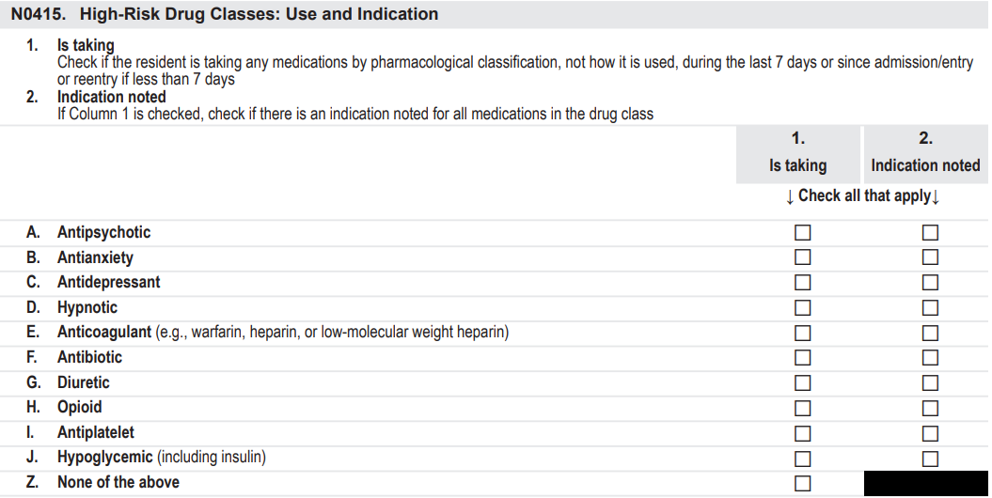
High-Risk Drug Classifications
Column 1 – Check any medications received by the resident during the 7 day look back period.
Column 2 – Check if there is an indication noted for any medication checked in Column 1.

Slide 11
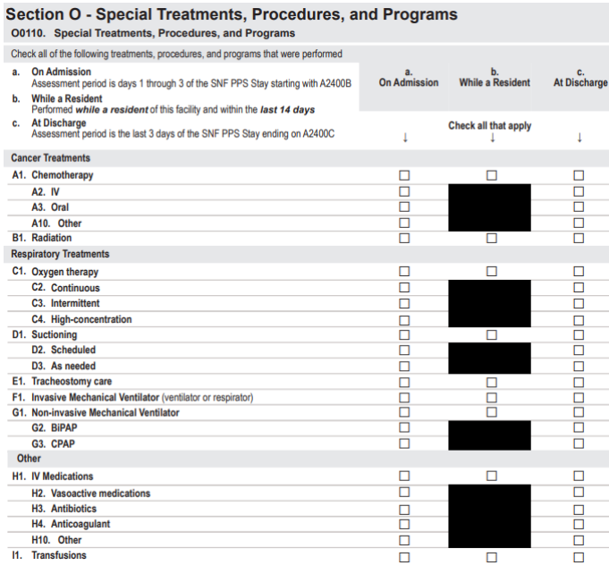
Section O
Special Procedures, Treatments, & Programs
Expanded Treatments
New Items
Hospital Lookback Period Eliminated

Slide 12
Special Treatments
O0110C1 – Oxygen Therapy
  Continuous delivered for 14 hours or greater per day
  Intermittent delivered less than 14 hours per day
  High Concentration - Oxygen delivered at a concentration that exceeds FiO2 of 40%
O0110H1 – IV Medications
  O0110H2 – Vasoactive medications
  O0110H3 – Antibiotics
  O0110H4 – Anticoagulation
  O0110H10 – Other
O0110J1 – Dialysis
  O0110J2 – Hemodialysis
  O0110J3 – Peritoneal Dialysis
O0110O1 – IV Access
  O0110O2 – Peripheral
  O0110O3 – Midline
  O0110O4 – Central including PICC, tunneled, and port

Slide 13

New Quality Measures
Quality Reporting Program

Slide 14
New Quality Reporting Program (QRP) Measures
Transfer of Health Information to the Provider Post-Acute Care
Transfer of Health Information to the Patient Post-Acute Care

Slide 15
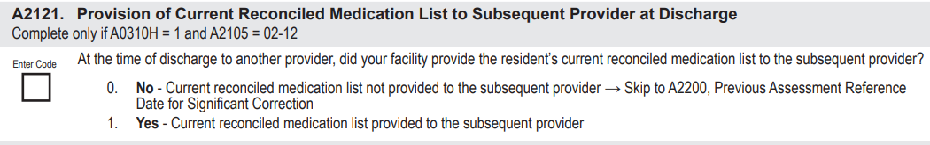
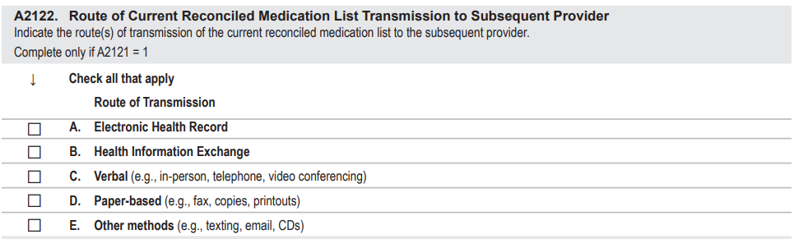
Provision of Current Reconciled
Medication List to Subsequent Provider

Slide 16
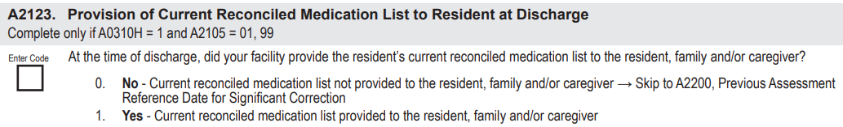
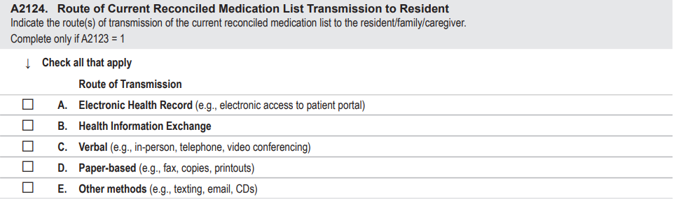
Provision of Current Reconciled
Medication List to Resident

Slide 17

Section G Retires
Section G (Functional Status) merges with Section GG (Functional Abilities and Goals)
  CNAs documentation
  Care Area Assessment (CAAs) impact
  Quality Measures
Some items in Section G will be carried over to Section GG with new Item #
  Range of Motion
  Mobility Devices
  Personal Hygiene
  Tub/Shower Transfer

Slide 18
5 Quality Measures
Percent of Residents Who Make Improvement in Function (SS)
Percent of High-Risk Residents with Pressure Ulcers (LS)
Percent of Low-Risk Residents Who Lose Control of Their Bowel and Bladder (LS)
Percent of Residents Whose Need for Help with ADLs has Increased (LS)
Percent of Residents Whose Ability to Move Independently Worsened (LS)

Slide 19
Section GG Functional Abilities & Goals
OBRA and PPS Assessments
Admission Status
Discharge Status on End of SNF PPS Stay
Goals are set for PPS 5-day assessment
Usual Performance
3 Day Lookback Period
Extensive Coding Clarifications

Slide 20
Look Back Periods Change
Type of MDS Assessment | Look Back
Admission Assessment (Stand Alone) | First 3 days of the Stay (A1600)
Initial Medicare 5 Day PPS Assessment | First 3 days of the Medicare Stay (A2400B)
Combined PPS 5 Day + Any OBRA Assessment | First 3 days of the Medicare Stay (A2400B
OBRA Assessment Other than Admission (Quarterly, SCSA) | ARD (A2300) + 2 Previous Calendar Days
Interim Payment Assessment (IPA) | ARD (A2300) + 2 Previous Calendar Days
Part A Discharge (End of PPS Stay) | Last covered Medicare Day (A2300C) + 2 Previous Calendar Days
Combined OBRA Discharge + Part A Discharge | Last covered Medicare Day (A2300C) + 2 Previous Calendar Days

Slide 21
Transition from G to GG Coding
Today - Section G
October 1st – Section GG
Independent
Supervised
Limited Assist
Extensive Assist
Dependent
Activity Occurred 1-2
Activity Did Not Occur
Independent
Set or Clean Up Assistance
Supervision or touching Assistance
Partial / Moderate Assistance
Substantial / Maximal Assistance
Dependent
Resident Refused
Not Applicable
Not Attempted due to Environmental Limitations
Not Attempted due to Medical or Safety Concern

Slide 22

Take Steps Now
Examine interdisciplinary process
  Discharge Planning and Communication
  Medication Reconciliation
  Medication Indications
Update policies and procedures
Ensure accurate coding
  Data Collection
  Paper vs Electronic documentation
  Assessment modification to collect data
Monitor and track outcomes

Slide 23

Education Plan
Education of IDT members to MDS changes and impact
CNAs Education
ADL documentation for Section GG
Medication Reconciliation
Documentation
Don’t Wait…Act Now!!

Slide 24

MDS 2023 Starts
Sunday, October 1st

